Slide 1


IWIRC
Board Orientation
December 2025

Slide 2


Agenda
About IWIRC
About the Board
Committee Overview
Strategic Plan Task Force
Finance Overview
Annual Awards
Initiatives
Resources

Slide 3
Mission Statement
We are committed to the connection, promotion, and success of women
in the insolvency and restructuring professions worldwide.

Slide 4



Promise of
our brand
Networking & Connections
High value events
Personal & professional development

Slide 5





FAQs
The “idea” for IWIRC was born in 1993
The first members joined in 1994
The Founders were:
  Selinda Melnik, Attorney
  Laureen Ryan, Accountant
  Martha Fetner, Banker
Membership is comprised of every discipline
We do have men that are members
Currently over 2,400 members
  5 continents
  43 countries
  57 networks

Slide 6
Worldwide Reach
Region | % Membership
US | 37%
EMEA | 20%
Asia | 18%
Caribbean | 12%
Canada | 6%
LatAm | 6%
Other | 1%
Grand Total | 100.00%
First Name
Last Name
First Name
Last Name

Slide 7
IWIRC
Board of Directors

Slide 8
All Board, Committee, and Advisory Council members must sign the Code of Conduct and Ethics (COC)
  The COC was revised in October 2025 to ensure that all leaders recognize the importance of the collegiality and cooperation that is required to do the work of IWIRC
Differences of opinion are valued and appreciated in accordance with the professional guidelines outlined in the COC
Code of Conduct & Ethics

Slide 9
Code of Conduct & Ethics to be completed here
Yearly Conflict of Interest Form to be completed here
Attend all Board meetings and working group sessions
Attend annual Leadership Summit
Involvement at the local and regional network level
Timely submit written report before each full board meeting
Review Terms of Reference and offer input/updates as needed
Expectations for Board Members

Slide 10


2026 Meetings
Q1 Board Meeting March 5, 2026
Q2 Board Meeting May 14, 2026
Q3 Board Meeting September 17, 2026
Q4 Board Meeting November 5, 2026

Slide 11
Annual Leadership Summit to which all Board of Directors, Advisory Council, Network Chairs, and Strategic Plan Task Force members are invited and expected to attend if able.
Application Process: 10 slots available by application
January 15 Notice sent to members to apply
February 13 Applications due
Feb/March Member Services committee reviews and selects
March 10 E-Board finalizes list
March 15 Applicants notified
Leadership
Summit
June 2-3, 2026
Dublin, Ireland

Slide 12

Executive Committee
Chair
Vice Chair
Finance Director
Past Chair
Eloise Matsui
Hong Kong
Tara Schellhorn
New Jersey
Jo Hewitt
London
Evelyn Meltzer
Delaware
Governance & Risk
Operational Management Director
Anne Vanderkamp
Chicago
Global Director
Stuti Jain
Singapore
Sara-Ann Wilson
Ontario

Slide 13
Regional Directors
Asia Regional Co-Director
Asia Regional Co-Director
Canada Regional Director
Claudia Cheah
Malaysia
Catriona Lim
Hong Kong
Nerina Jahja
Ontario
Caribbean Regional Director
EMEA
Regional Co-Director
EMEA
Regional Co-Director
Gemma Bellfield
Cayman Islands
Luci Mitchell-Fry
London
Grainne King
Europe
Latin America Regional Director
U.S.
Regional Co-Director
U.S.
Regional Co-Director
Liv Machado
Brazil
Krystal Mikkilineni
Midwest
Alison Franklin
Georgia

Slide 14
Programming Directors
International/Flagship Conference Co-Director
International/Flagship Conference Co-Director
Asia Conference Co-Director
Asia Conference Co-Director
Kizzy Jarashow
New York
Aisling Dwyer
Hong Kong
Kai Yun Tan
Singapore
Sharon Chong
Malaysia
US (IWIRC@ABI)
Conference Co-Director
US (IWIRC@ABI)
Conference Co-Director
US (IWIRC@NCBJ)
Conference Co-Director
US (IWIRC@NCBJ)
Conference Co-Director
Jen McConnell
Chicago
Brittany Michael
Minnesota
Amy Vulpio
Greater Philadelphia
Megan Clontz
Dallas/Fort Worth
Virtual Programming Co-Director
Virtual Programming Co-Director
Jennifer Lyday
Carolinas
Alexia Adda
Cayman Islands

Slide 15
Management Committee
Member Services Co-Director
Bodie Cowell
New England
Member Services Co-Director
Kara Harmon
Chicago
Member Services Vice Director
Adine Momoh
Minnesota
Communications Co-Director
Communications Co-Director
Melissa Sydow
Florida
Chrissy Sanfelippo
Chicago
News Director
Sandy Yeung
Singapore
Social Media Director
Diversity, Inclusion & Belonging Co-Director
Debby Lim
Singapore
Diversity, Inclusion & Belonging Co-Director
Monica Blacker
Dallas/Fort Worth
Diversity, Inclusion & Belonging Vice Director
Dominique Douglas
Central Texas
Roopa Somasundaran
India
New Network & Regional Development Co-Director
Bea Faneca
Brazil
New Network & Regional Development Co-Director
Maneesha Dhir
India
UNCITRAL Committee Co-Director
Olya Antle
Virginia
UNCITRAL Committee Co-Director
Katharina Crinson
London
Finance Vice Director
Julia Marshall
London
Judicial Liaison
2025 Rising Star
Hon. Elizabeth Gunn
Washington DC
Amita Chohan
Europe

Slide 16
Advisory Council
Leslie Berkoff
Term ends Dec. 31, 2026
Hon. Mary Grace Diehl
Term ends Dec. 31, 2026
Rita Gismondi
Term ends Dec. 31, 2026
Jennifer Kimble-MacGreevey
Term ends Dec. 31, 2026
Pooja Sinha
Term ends Dec. 31, 2026
Hon. Lori Vaughan
Term ends Dec. 31, 2026
Sejal Kelly
Term ends Dec. 31, 2027
Blanche Zelmanovich
Term ends Dec. 31, 2027

Slide 17
IWIRC
Committees

Slide 18

Committees
Programs
Communications and News
Member Services
Regional Directors
Networks
Diversity, Inclusion & Belonging
Finance
New Networks and Regional Development
Nominating
UNCITRAL
Awards

Slide 19
Recommends substantive IWIRC programs and projects, as well as topics and agenda items for events.
Develops technical program for IWIRC conferences, including panel topics, speaker suggestions, and ideas for intermezzo/networking activities. Works closely with IWIRC Administrative Director and team.
The number of Program Committees for the year will be determined by E-Board. For 2026:
  Flagship Conference Committee is responsible for the annual Flagship Conference (Dublin);
  Asia Regional Programming Committee is responsible for the Asia Regional Conference;
  U.S. Programming Committee is responsible for IWIRC@ABI (Spring) and IWIRC@NCBJ (Fall);
  Virtual Programming Committee is responsible for coordinating IWIRC virtual programming.
The Program Committees each report directly to the Operational Management Director and shall make recommendations regarding programming to the Operational Management Director.
Program Committees

Slide 20




Chaired by the Communications Co-Directors and shall be comprised of the Communications Co-Directors, the Vice Director of News, the Vice Director of Social Media, and a up to 5 other members.
Implements a proactive media relations strategy, including preparing and distributing press releases and regular communication with members.
  Thinking strategically and creatively about content.
  Reviewing newsletter, website, and social media posts.
  Soliciting ideas for members in the news, network news, profiles, etc.
Reports directly to the Operational Management Director.
IWIRC Communications Policy can be found here.
Social Media
  Facebook: https://www.facebook.com/IWIRCIntl/
  Instagram: https://www.instagram.com/iwirc_international/
  Linkedin: https://www.linkedin.com/company/iwirc
  Youtube: https://www.youtube.com/user/IWIRC
E-newsletters (send member and network news to news@iwirc.com).
Website www.iwirc.com: resources available to members.
Communications & News Committee

Slide 21
Comprised of Member Services Co-Directors, the Vice Director of Member Services, and a maximum of 5 other members.
Responsible for membership building and member engagement activities, including liaising with members, member recruiting and retention programs, new member initiatives, overseeing any mentoring program, and surveying members to develop and gauge additional membership benefits.
  Developing innovative and fun ideas to engage and connect and recruit IWIRC members globally.
  Reviewing IWIRC New Member Brochure and New Member Welcome Letter.
  Conducting outreach to new members.
  Hosting and attending new member receptions (in-person and virtual).
  Reviewing applications to attend the annual Leadership Summit and proposing slate.
Reports directly to the Operational Management Director.
Member
Services Committees

Slide 22
Comprised of the Diversity, Inclusion & Belonging Co-Directors, the Vice Director of Diversity, Inclusion and Belonging, and a maximum of 10 other members.
Recommends initiatives to the E-Board and the Board to promote diversity, inclusion and belonging among IWIRC members and networks.
The responsibilities of the DIB Committee will be further refined by the Executive Committee in early 2026.
Reports to the Governance and Risk Director.
Diversity, Inclusion, &
Belonging Committee

Slide 23
Comprised of Finance Director, the Vice Finance Director, and a maximum of 8 other members.
Note: must certify compliance with confidentiality policy.
Responsible for providing oversight and advice to E-Board on financial aspects of IWIRC, including the annual budget, review of financial statements, review of the annual investment statements, and sponsor development and communications with IWIRC’s annual sponsors.
  Assist in the development and oversight of annual budget and financial statements.
  Review annual audit report and tax return.
  Review and comment on balance sheets, profit and loss statements, budgets, and investment reports.
  Develop sponsorship materials and benefits and conduct outreach to sponsors.
  Regularly review and update finance policies, including the Investment Policy and Audit Review Policy.
Reports directly to the E-Board.
Finance
Committee

Slide 24
Comprised of the Global Director and the Regional Directors.
Means of reporting, coordination and collaboration for the Regional Directors through meetings and workshops and opportunities to exchange information regarding membership, programming, leadership and other issues facing the regions and Regional Directors and their respective regions.
  Facilitate collaboration and the exchange of information across regions.
  Share updates and best practices related to membership growth, programming, and leadership.
  Identify and discuss common challenges and opportunities facing regional networks.
  Promote consistency and cohesion in network operations and governance across regions.
Expected to meet bi-monthly (6 times a year).
Regional
Directors
Committee

Slide 25
Comprised of the Regional Director(s) for their respective region and Network chairs from regions.
  Regions: Asia, EMEA, U.S., Canada, Caribbean, and Latin America.
  There shall be a Network Committee for each applicable region covered by a Regional Director.
Expected to meet quarterly (4 times a year).
Report to the Global Director.
Networks
Committee

Slide 26
Comprised of New Networks & Regional Development Co-Directors and up to 5 other members.
Supporting launching of new networks in regions in which IWIRC does not yet have a presence and assisting Regional Directors and network directors. Responsible for other regional development, such as promoting IWIRC in regions in which IWIRC does not yet have a presence.
  Assisting with forming new networks where no/little IWIRC presence (Africa, Middle East, Oceania).
  Identifying locations for new networks, IWIRC events, or IWIRC sponsorship of events.
  Engaging with the regional directors and network directors in regions with an IWIRC presence (e.g., Asia, the Caribbean, EMEA, and Latin America) to coordinate efforts re: new networks.
  Coordinating the development of materials supporting new networks and regional development.
Expected to meet at least quarterly (4 times a year).
Reports to the Global Director.
New Networks & Regional Development
Committee

Slide 27
Chaired by the Immediate Past Chair and comprised of the Chair, Vice Chair, Immediate Past Chair, Finance Director, and at least 3 other members chosen by the Immediate Past Chair (considering diversity of practice, geography, race/ethnicity), 1 of whom should be on the Advisory Council.
On or before October 15 of each election year, the Nominating Committee shall review all nominations received by the organization and shall prepare a nominating board slate.
  The slate shall be presented to the E-Board for approval.
  Once approved by the E-Board, the slate is presented to the Board of Directors to approve.
  Approves slate of committee membership.
  Assists with filling Committee openings as they arise.
Meets as needed in September/October to complete review and slating.
Reports directly to the E-Board.
Nominating
Committee

Slide 28
Email soliciting nominations July 15
Nominations due September 15
Nominating committee prepares slate October 15
E-Board approves slate by October 23
Board approves slate by November 6
Committee chairs prepare slates November 30
Committees approved December 18
Nominating
Committee

Slide 29
Chaired by UNCITRAL Committee Co-Chairs. Opportunity to serve on the Committee is available to all IWIRC members—there is no limit on numbers as to who can serve on the UNCITRAL Committee.
Serves as a technical expert participant to UN’s Commission on International Trade Law (UNCITRAL):
  Working Group V (insolvency); and
  Working Group II (dispute settlement).
Reviews proposed legislation and commentary, prepares comments to the UN Secretariat, coordinates IWIRC’s delegation to UNCITRAL meetings, and liaises with other NGOs/member nations.
Selects 4-5 committee members to represent IWIRC at UNCITRAL meetings, in New York and Vienna.
  Co Chairs will make selection based on suitability, expertise, continuity, and geographic diversity.
Meets as scheduled by Co-Chairs with separate calls for WG II and WG V as needed.
Reports to the Vice-Chair.
UNCITRAL
Committee

Slide 30
The Judicial Liaison is a voting member of the Management Committee of the Board of Directors of IWIRC and shall generally be responsible for coordinating initiatives with the judiciary including engaging judges in IWIRC activities and initiatives.
The Rising Star award winner from the previous year is a voting member of the Management Committee.
Judicial
Liaison
&
Rising Star

Slide 31
Comprised of a diverse group of individuals who share a strong commitment to IWIRC, its missions and goals
Ambassadors of IWIRC and use their reputations, networks, seniority and experience to support the growth and development of IWIRC
Mentor members of the Board
Represent the Board at industry and international events
Assist in strategic planning as requested by the Executive Committee
Advisory
Council

Slide 32
An Awards Committee was established in 2025 to assist E-Board with selection of awards presented at IWIRC’s signature events
Reviews nominations and meets to discuss and assesses candidates
Makes recommendation to E-Board on award recipients
Awards

Slide 33
Strategic Plan
Task Force

Slide 34
Announced summer 2024
Comprised of a small group of geographically diverse and committed group of IWIRC members to meet bi-monthly to set priorities and action items
Reports to and works closely with the E-Board and Admin team
3-year commitment (July 2024-2027).
Terms of reference can be found here
Strategic Plan Task Force

Slide 35
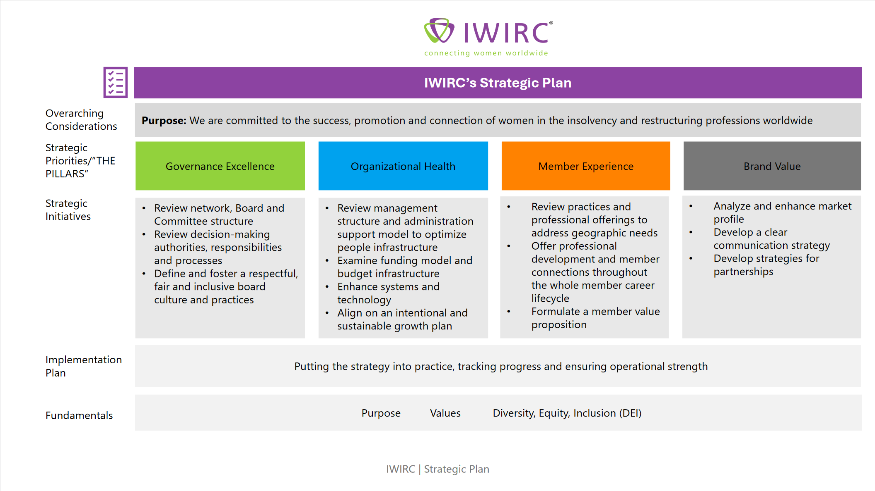

Slide 36
First | Last | Network | Country | Profession
Rebecca | DeMarb | Wisconsin | USA | Lawyer
Beatriz | Faneca | Brazil | Brazil | Lawyer
Jennifer | Kimble MacGreevey | New York | USA | Lawyer
Grainne | King | Cayman | Cayman | Lawyer
Pooja | Mahajan | India | India | Lawyer
Aruni | Weerasekera | Hong Kong | Hong Kong | Financial Advisor
Sara-Ann | Wilson | Ontario | Canada | Lawyer
Blanche | Zelmanovich | New York | USA | Financial Advisor
Catriona | Lim | Hong Kong | Hong Kong | Financial Advisor
Luci | Mitchell-Fry | London | UK | Attorney
Strategic Plan Task Force
The IWIRC Vice Chair and Governance & Risk Director will serve as Co-Chairs and will change as new Board is elected.

Slide 37
IWIRC
Awards

Slide 38


Woman of the Year in Restructuring Award (WOYR)
Each year, IWIRC honors a woman for her recent contributions (12-24 months) as part of the insolvency and restructuring industry with the Woman of the Year in Restructuring (WOYR) award.
Nomination form
Women of Restructuring Hall of Fame Award
Since 2022, IWIRIC has also honored a woman for her career contributions to the insolvency and restructuring industry with the Women of Restructuring Hall of Fame award.
Nomination form
For both awards:
Can be from any facet of the restructuring world (may be an attorney, judge, banker, turnaround manager, academic, or other restructuring industry professional).
Can be actively working or retired.
From anywhere in the world.
IWIRC membership is not a requirement to make a nomination, nor to be honored.
Timeline
  Initial call for nominations December 2, 2025
  Nominations due February 16, 2026
  Nominations sent to Committee February 17
  Recommendation to E-Board March 3
  E-Board approves March 10
  Winners announced March 16
  Awards presented IWIRC@ABI April 23
WOYR &
Restructuring Hall of Fame

Slide 39

As the premier advocacy group for women in restructuring, IWIRC recognizes the value in recruiting and promoting women throughout their careers. IWIRC established its Founders Awards in recognition of members and networks which have made exceptional contributions to the organization, their clients, and the profession overall.
Melnik Award, honoring founding Chair Selinda Melnik, recognizes a member whose contributions to IWIRC have been exceptional.
Fetner Award, honoring founding Vice Chair Martha Fetner, is awarded to a member for exemplary service to IWIRC, through efforts over the past year or several years, specially aimed at bringing members together through regional and international conferences, efforts and relationships.
Ryan Award, honoring founding Secretary/Treasurer, Laureen Ryan, is awarded to the IWIRC Network that best exemplified IWIRC in the past calendar year.
  Initial call for nominations February 1
  Nominations due March 13
  Nominations sent to Committee March 16
  Recommendation to E-Board April 7
  E-Board reviews and approves April 14
  Winners announced April 22
  Awards presented @ Leadership June 4
Founders Awards

Slide 40

Each year, IWIRC recognizes and honor the “Rising Stars” of the organization.
8 years or less experience in the insolvency & restructuring industry
Active involvement in promoting IWIRC – locally, nationally and/or internationally
Has inspired, created, led and/or served on a Board of an IWIRC Network or committee
Has shown exceptional leadership
Has made an extraordinary contribution to IWIRC and/or an IWIRC Network
5 finalists are selected and invited to attend IWIRC@NCBJ to be recognized.
  Initial call for nominations May 13
  Nominations due July 6
  Nominations sent to Committee July 8
  Recommendation to E-Board August 3
  E-Board reviews and approves August 11
  Winners announced August 17
  Awards presented @ ABI@NCBJ October 7
Rising Star
Award

Slide 41
IWIRC
Finance

Slide 42

Finance
IWIRC has 2 main sources of income: dues (75%) and sponsorships (25%).

Slide 43
Dues
Membership dues are tiered:
Region | % Members | % of Payments
US | 37% | 40%
EMEA | 20% | 25%
Asia | 18% | 9%
Caribbean | 12% | 15%
Canada | 6% | 7%
LatAm | 6% | 3%
Other | 1% | 1%
Grand Total | 100.00% | 100.00%
First Name
Last Name

Slide 44
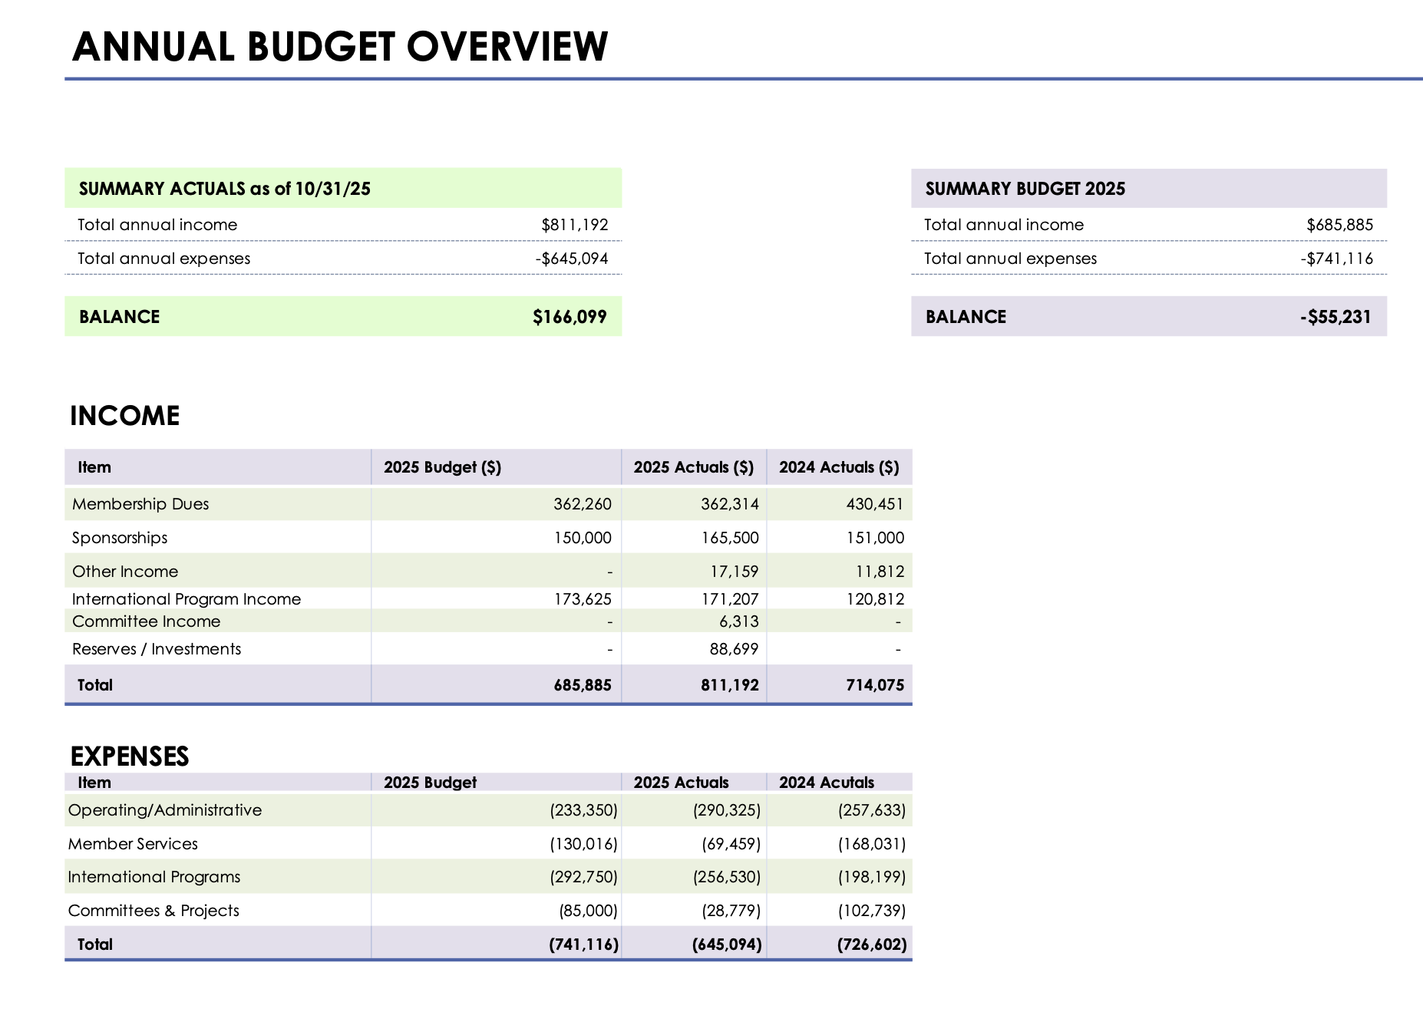
2025 Financials

Slide 45
Budget Timeline
Committees budget requests due July 1
Admin team prepares draft budget July 15
Finance Committee approves budget August 28
E-Board reviews and approves drafts budget September 8
Board reviews and approves budget September 17
Sponsorship
IWIRC relies on sponsors for approximately 25% of its annual funding
Finance Committee reviews levels and benefits to recommend to E-Board
  Initial sponsorship planning call April
  Launch sponsorship campaign June @ Leadership Summit
  First reach out September
Information re: sponsor benefits https://www.iwirc.com/about-us/sponsor-info
Pledge form https://form.jotform.com/252024155043141
Budget &
Sponsorship

Slide 46
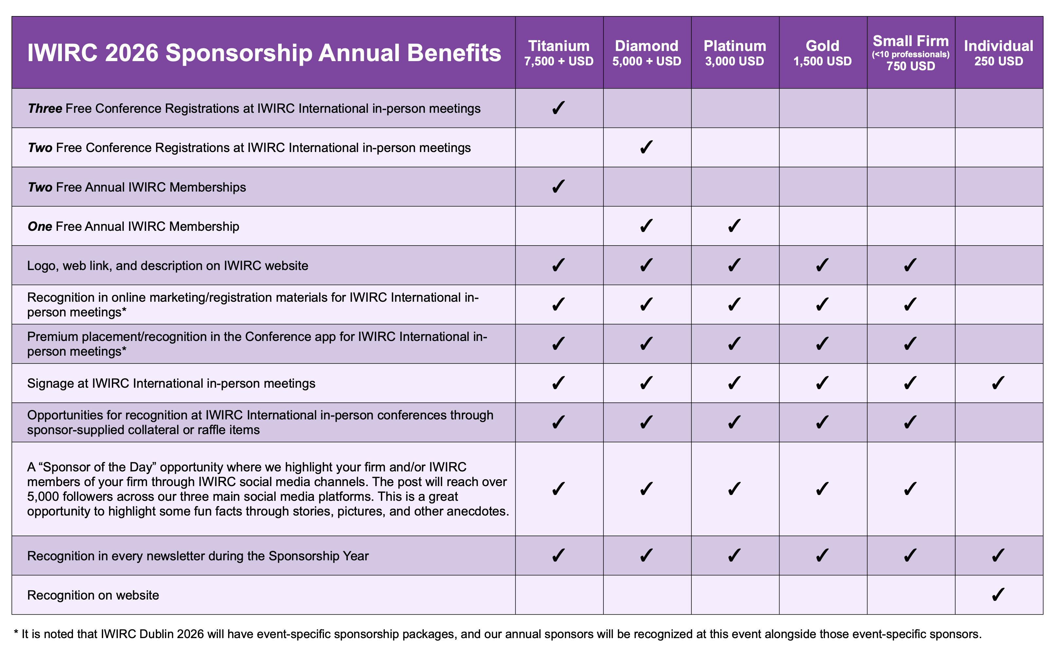
Sponsorship

Slide 47
Travel stipends are available (by application) to IWIRC leaders and IWIRC members who are materially participating in a conference and whose travel expenses are not being reimbursed by their employer.
Click here to access the stipend request form.
  Travel stipends are limited to 1 per person per year
  Subject to a budget approved by the Board annually
  Applications for Travel Stipends shall be submitted BEFORE the event.
  If approved, Travel Stipend will be paid AFTER the event upon receipt of copies of expenses incurred
  Travel Stipends are available to cover travel only (not available to cover hotel or sundry expenses)
The Travel stipends are available as follows:
  Less than 5-hour flight USD500
  5-10 hour flight USD1,000
  More than 10-hour flight USD1,500
  → Please note, layovers do NOT count as flight hours.
Travel Stipends

Slide 48
Networks are encouraged to hold or sponsor events consistent with the goals of IWIRC.
  While it is expected that events will be funded by the Networks (through local sponsorship or admission fees), IWIRC International allocates a portion of the annual budget for grants to support the growth and development of the networks.
No more than 50% of the budgeted net cost will be covered by a grant.
Generally limited to 1 grant per Network per year.
Grants may be used for a variety of events/initiatives including:
  Network Signing Bonus
  Regional & Multiple Network Events
  Recruiting Events
$50,000 budgeted for Network Grants in 2026.
Click here to access the grant request form.
Grants

Slide 49
IWIRC
Initiatives

Slide 50
Communications and DIB: review the communications and DIB policies
Governance Structure: goal to analyze the IWIRC leadership structure resulted in:
  Amended bylaws
  New leadership structure
  New committee application process
  Drafting committee terms of reference
  Amended Code of Conduct and Ethics
Technology: investigate technology systems and improvements, including potential revamp of website
Finance: overhaul financial reporting for easier review
Programs: plan to hold inaugural flagship conference in 2026
2025 Initiatives

Slide 51
Governance Structure: implement new governance and committee structure
Programs: plan new International flagship conference
Technology: launch completely redeveloped website with new membership management system and events tracking
Brand value: analyze IWIRC brand value & identify ways to enhance
Committees: refine scope and responsibilities of DIB Committee
Finance: review membership dues and international sponsorship structure
Ongoing Initiatives

Slide 52
IWIRC
Resources

Slide 53
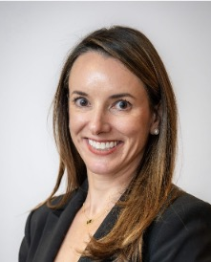
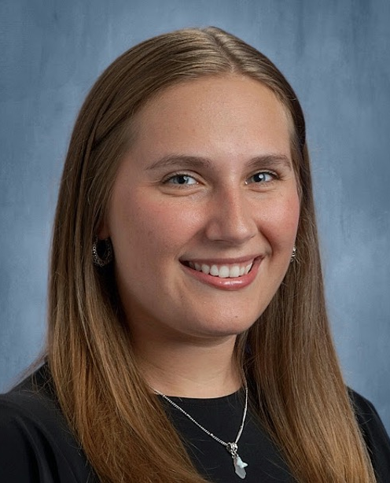
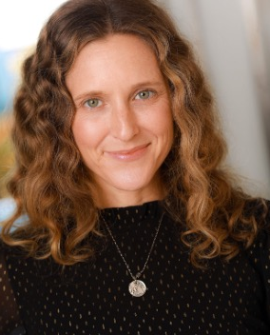
Our Team
CC Schnapp
Administrative Director
ccschnapp@iwirc.com
Sarah Farmer
Membership Services Director
sfarmer@iwirc.com
Rachel Lee
Bookkeeper
rlee@iwirc.com

Slide 54
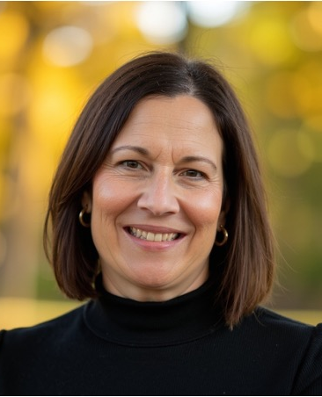
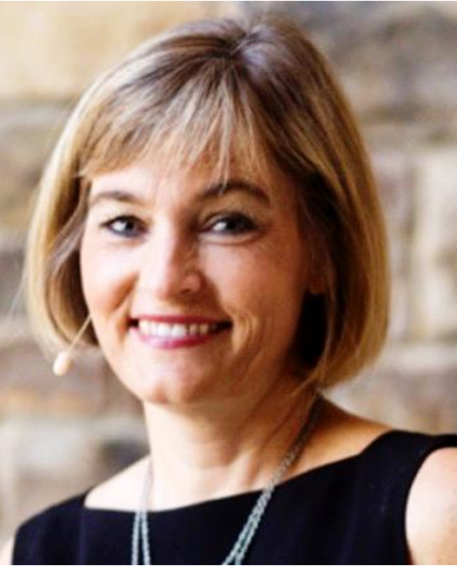
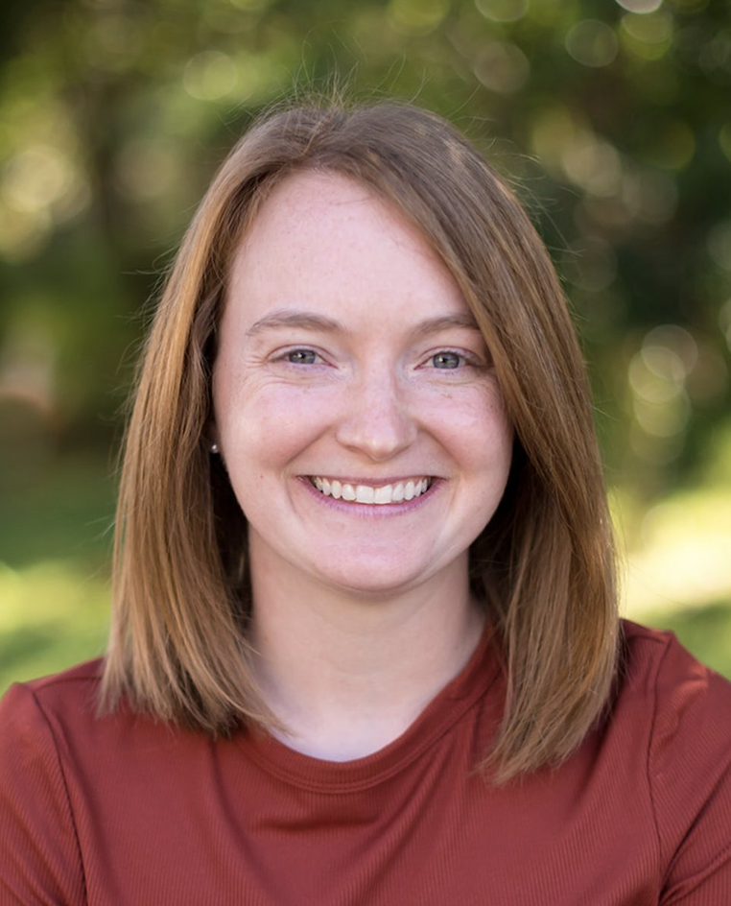
Our Team
Jennifer Lonero
Bookkeeper
jlonero@iwirc.com
Jenny Cudahy
Programs Director
jcudahy@iwirc.com
Michelle Foster
Communications Director
mfoster@iwirc.com

Slide 55
Thank You!
www.iwirc.com

